Slide 1
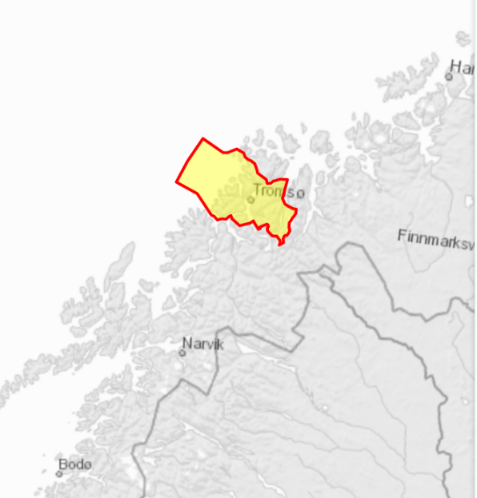
Ship traffic and economy in Tromsø and Norway
By: Edvard Davidsen and Sushmit Dhar

Slide 2
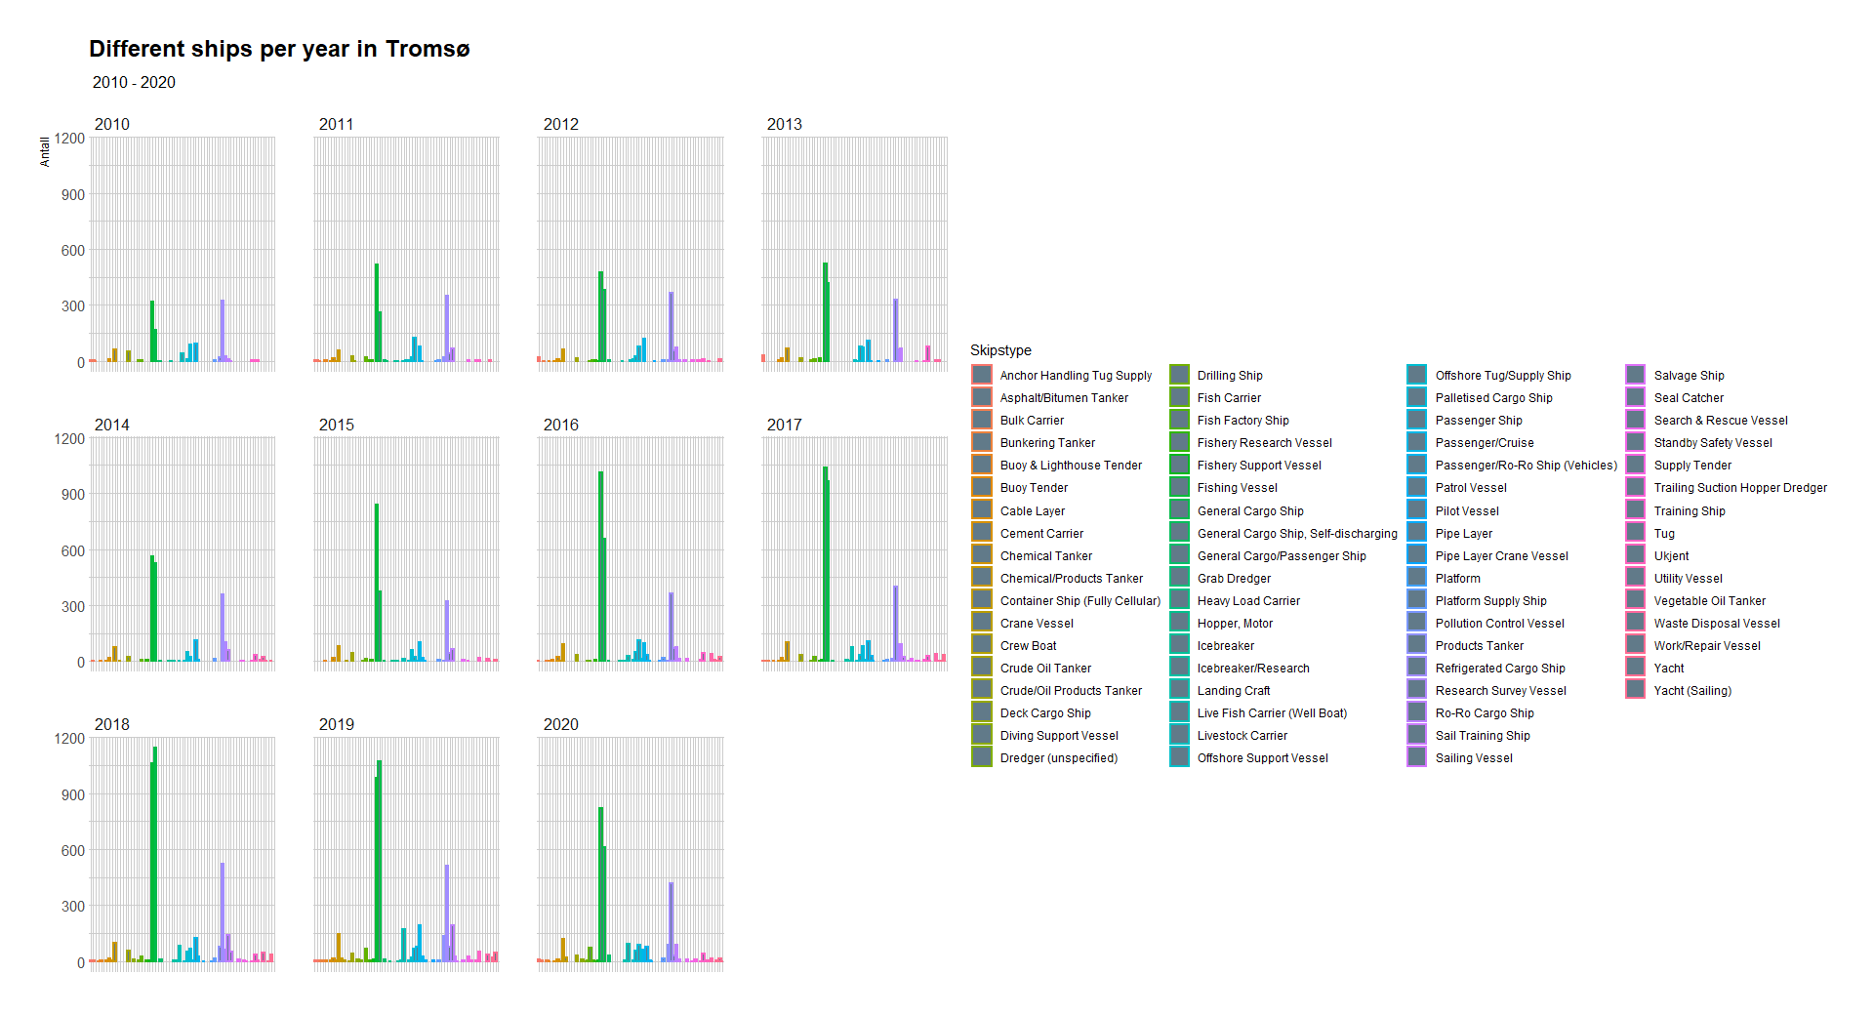
What ships are coming to Tromsø?
The amount of ships coming to Tromsø is increasing

Slide 3
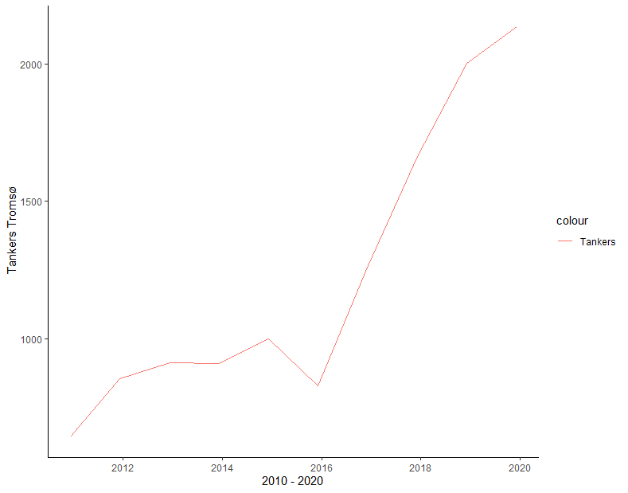
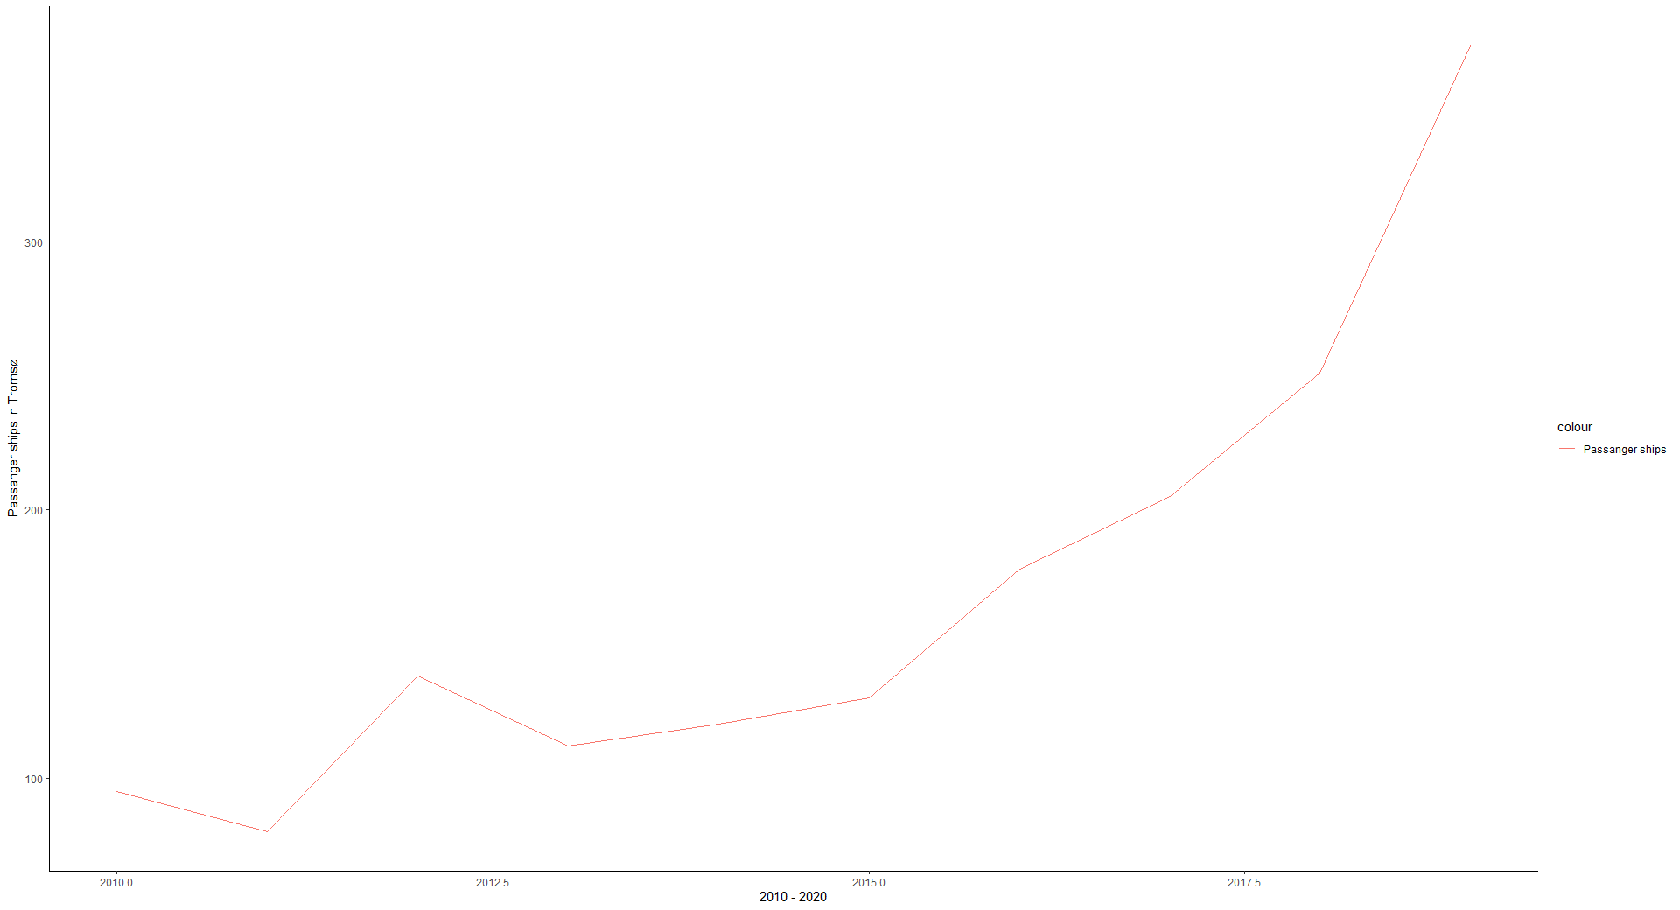
A closer look at ships in Tromsø
Both tankers and passanger ships are increasing

Slide 4
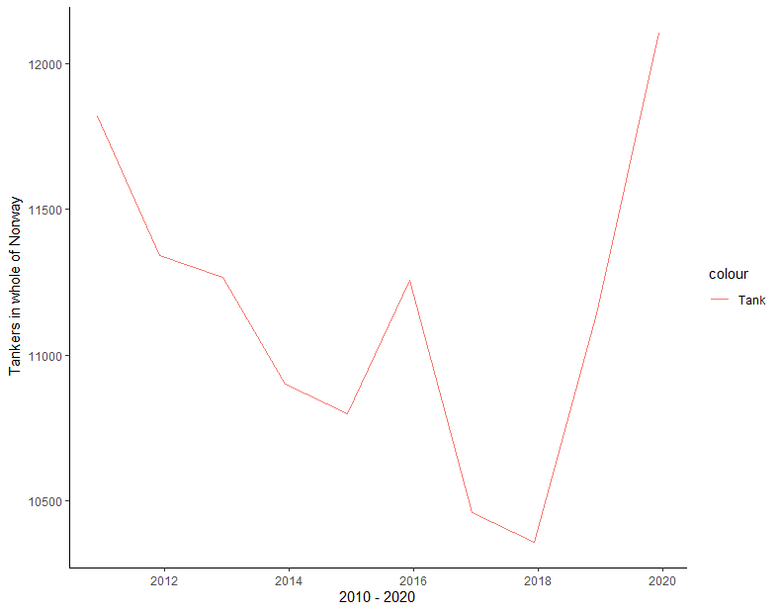
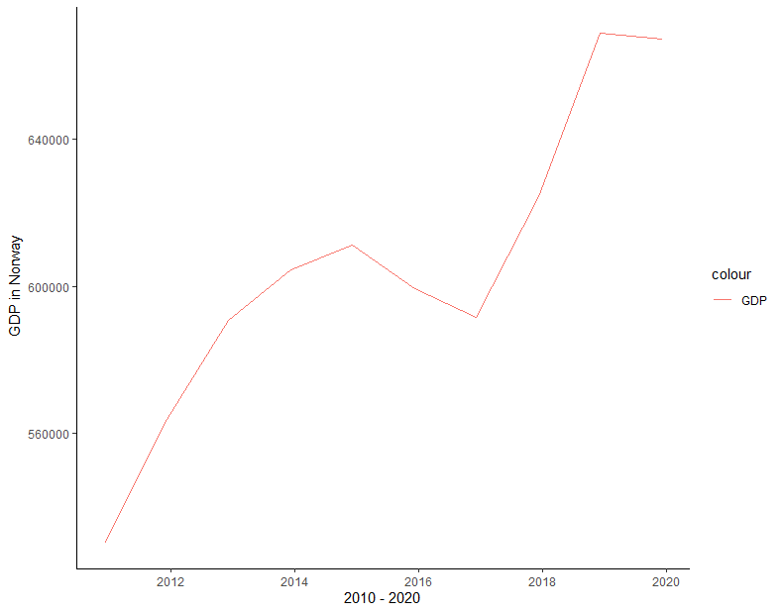
The whole of Norway

Slide 5
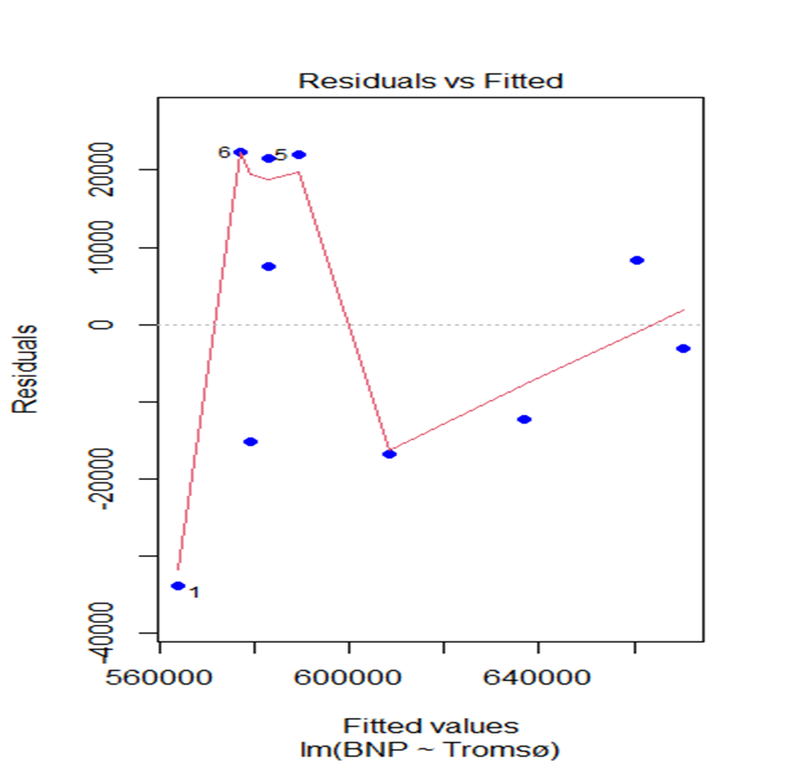
Is there a connection?

Slide 6
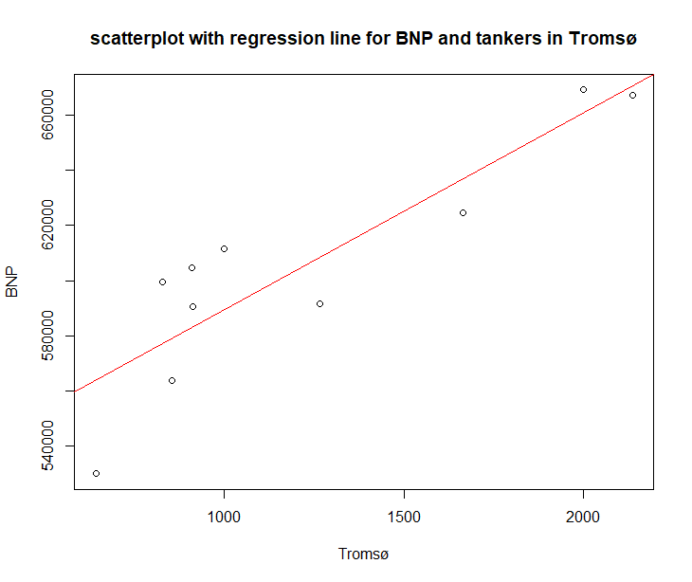
We think so
-R- squared = 0,789
-Adjusted value is almost the same

Slide 7
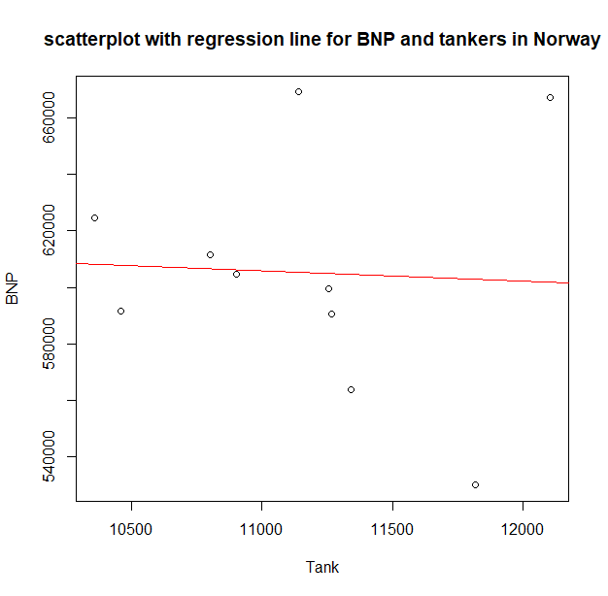
But not for the whole of Norway
-R-squared = 0,00214
-Adjusted value is negative
-Can be many reasons why

Slide 8
What to expect and where we want to go
It’s a fair assumption to make that activity of tankers and GDP is somewhat connected. More oil produced -> more tankers -> increase in GDP
Might look at the price of oil over the last 10 years.
Will try to see if there is any other ships that are linked to GDP in Tromsø/Norway

Slide 9
Data
Ship data from www.kystdatahuset.no
GDP data from https://www.ssb.no/nasjonalregnskap-og-konjunkturer/faktaside/norsk-okonomi
we’re waiting to see if Kartverket can give us more data to look at the tides and arrival times of ships.
All data sets will be on GitHub

Slide 10
Problems with the data
Some of the data is yearly, and this gives few obervation when looking at a 10 year periode.

